Slide 1
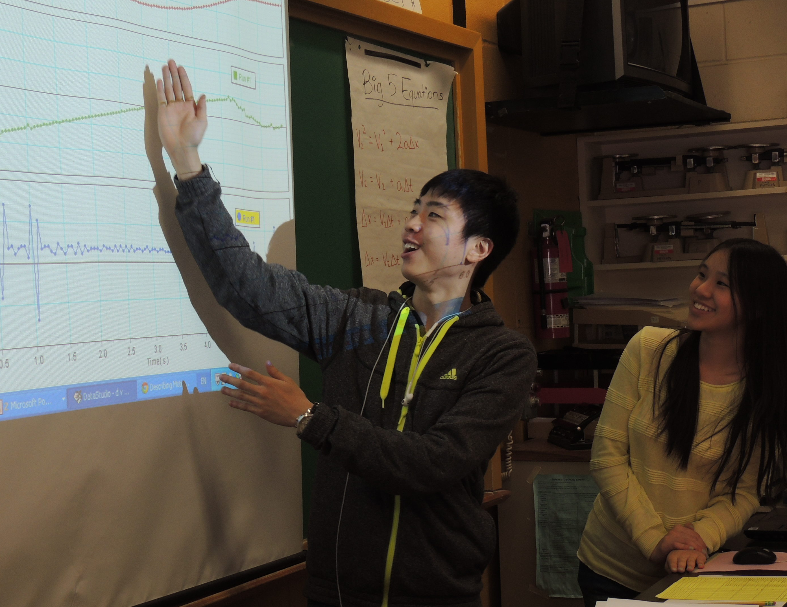
Harness Emotion to Improve Learning
Chris Meyer
York Mills C. I., Toronto District School Board
www.meyercreations.com/physics

Slide 2
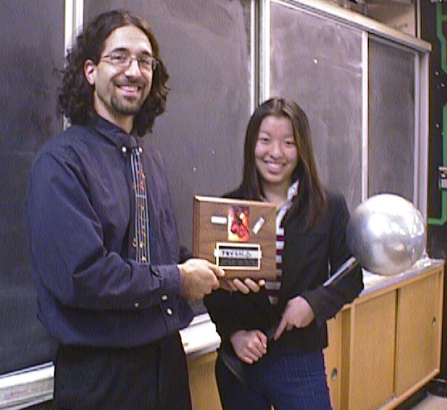
This guy would say …

Slide 3


Slide 4
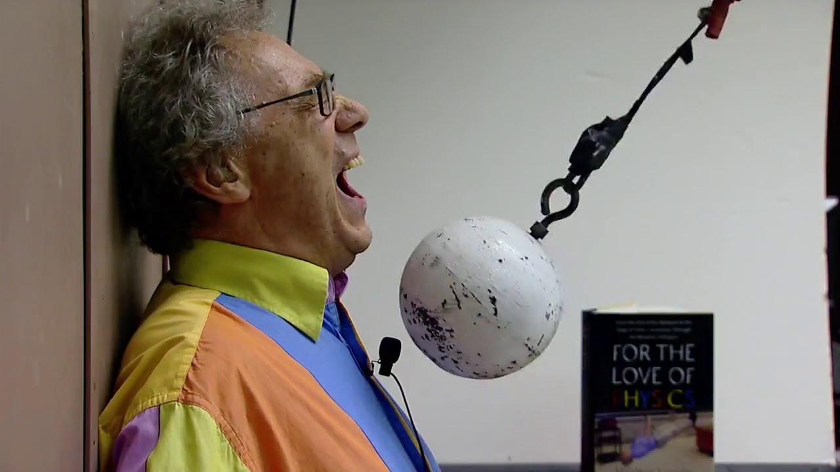
“Entertaining” Teachers
Notes:
Some teachers also have a mystical ability to spellbind and enthrall. To dazzle and inspire and make a deep emotional connection with people. Some have a great ability to …

Slide 5
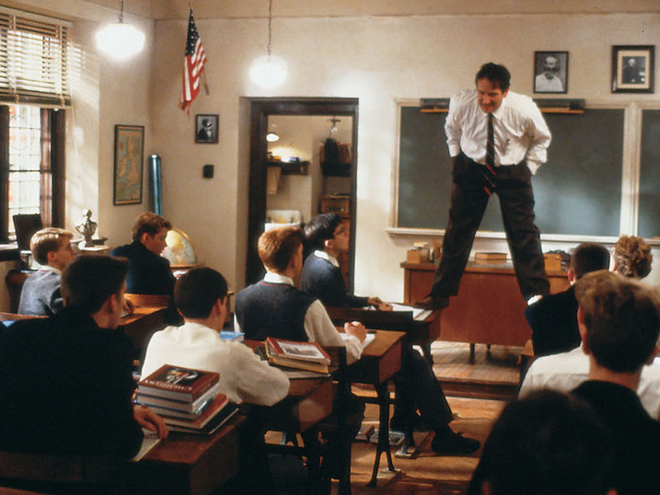
“Inspiring” Teachers
Notes:
stand on tables. You know someone’s really teaching when …
But wherein lies their power? How far does the power of the charismatic teacher extend?

Slide 6


Slide 7
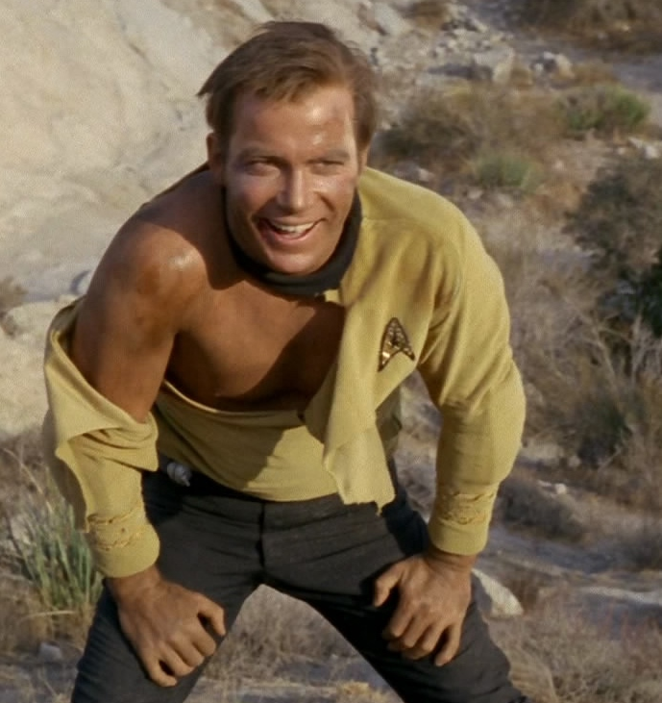
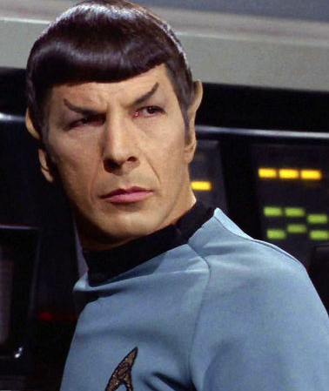
Who is our student?

Slide 8
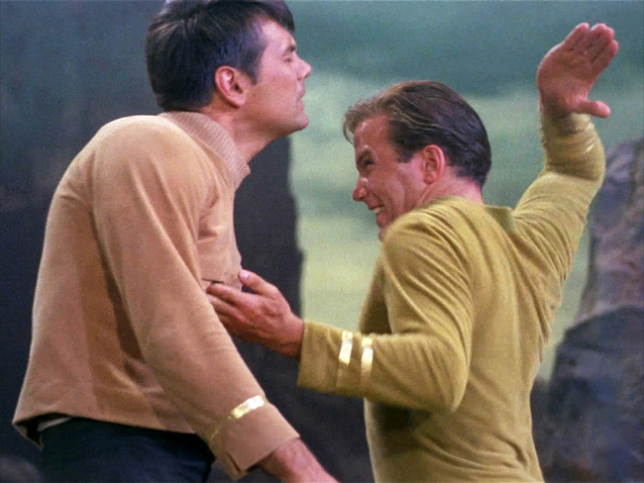
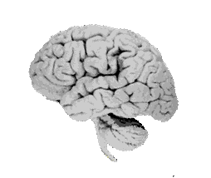
We get the humans

Slide 9
Survivor
What are the brain’s main tools for survival?

Slide 10
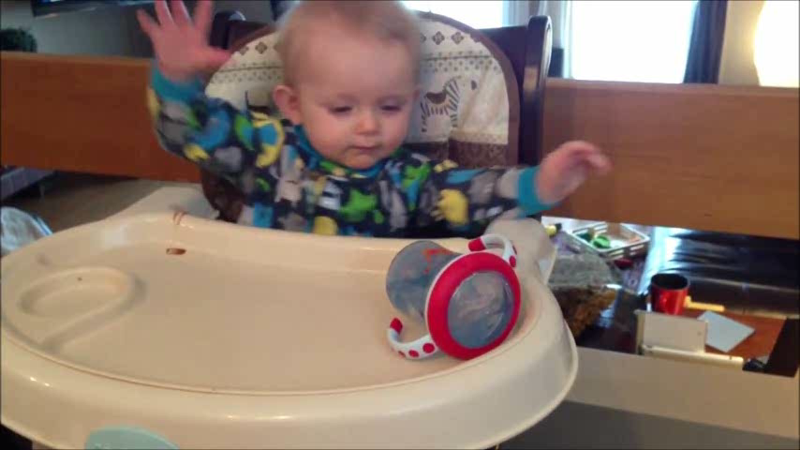
Understand its environment

Slide 11
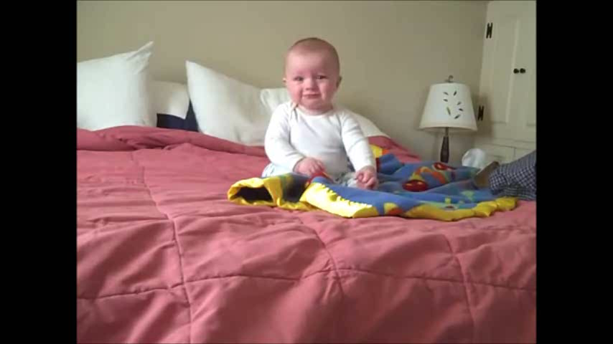
Control its body

Slide 12
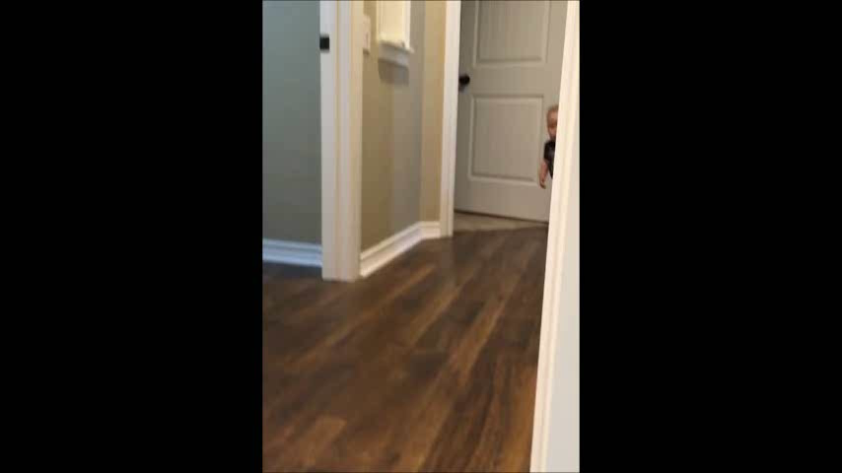
Avoid danger

Slide 13
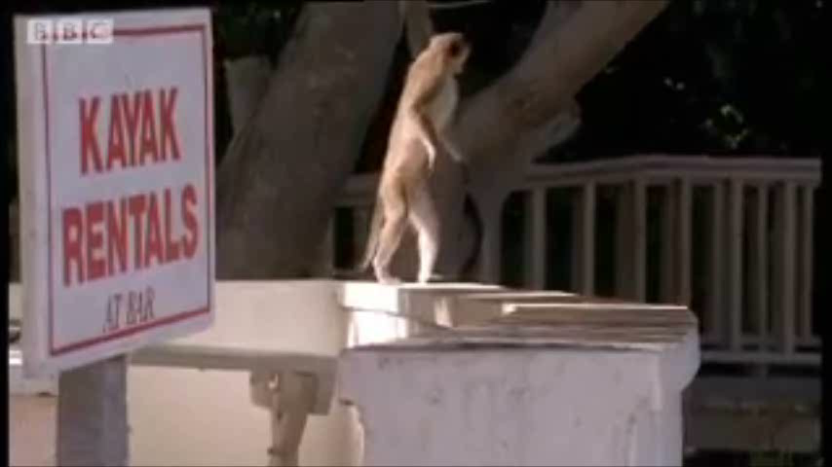
Find pleasurable things

Slide 14
Examples?
When learning in the classroom,
what are positive and negative examples of:
avoiding danger
finding pleasurable things
controlling one’s body

Slide 15
Understand its environment
Control body’s actions
Avoid danger
Find pleasurable things
Zull, J. The Art of Changing the Brain. 2002

Slide 16
cognition
control
survival
fear
pleasure
Zull, J. The Art of Changing the Brain. 2002

Slide 17
The Ancestral Brain

Slide 18
cognition
control
survival
fear
pleasure
Zull, J. The Art of Changing the Brain. 2002

Slide 19
cognition
“you will need to know this for…”
“just give it a try, you’ll see it’s not too hard …”
“better to get this work done sooner rather than…”

Slide 20
control
cognition
fear
pleasure

Slide 21
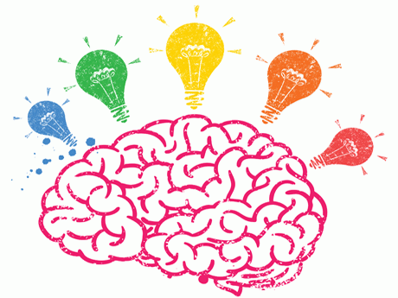
How does this brain like to learn?

Slide 22
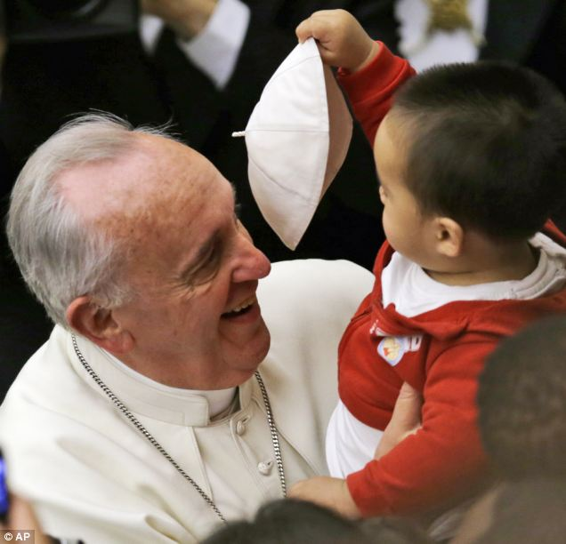
Let me!

Slide 23
Control
Survival Tool

Slide 24

Brains want control

Slide 25
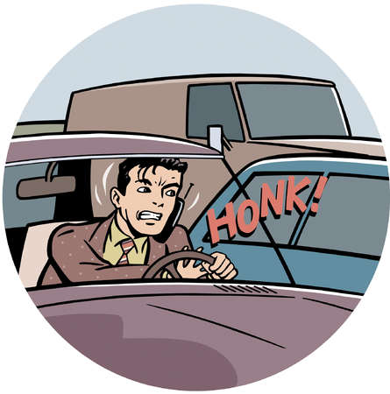
Brains want control

Slide 26

Brains want control

Slide 27
Teachers want control!
In a traditional classroom:
What aspect of a students’ behaviour are typically controlled?
What are the desired behaviours?

Slide 28
Classroom Control
Movement: face the front, sit still, write
Conversation: no personal or education talking, unless called upon
Ideas: teacher’s ideas good, students’ ideas later
And the lesson steamrolls on!

Slide 29
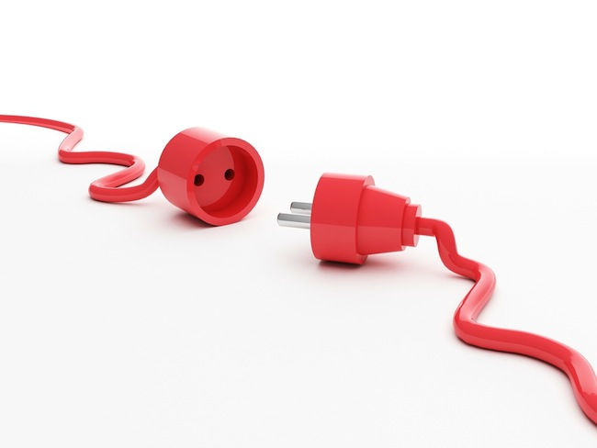
Classroom Control
Student actions have no effect
on the lesson, unless …
they are disruptive actions!

Slide 30
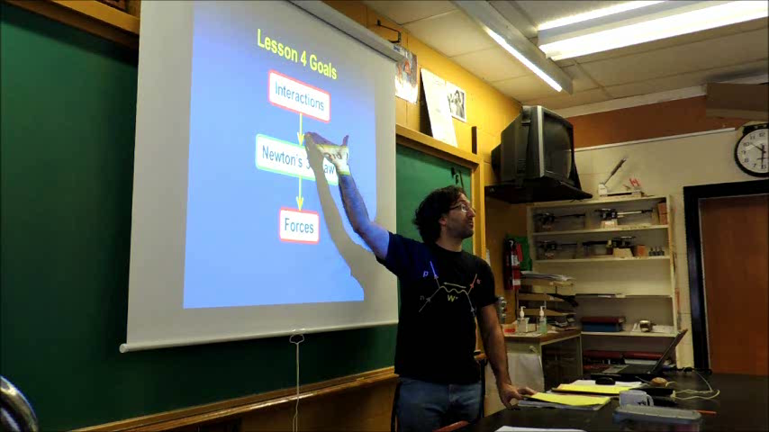
Classroom Control

Slide 31
Classroom Control
How are the norms of control changed?

Slide 32
Classroom Control
Movement: moving around
Conversation: students talking, at will!
Ideas: guided by questions, but following own thoughts
Student questions guide teacher

Slide 33
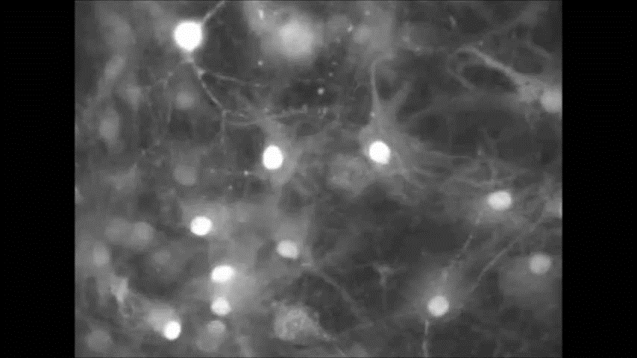
The Brain at Work

Slide 34
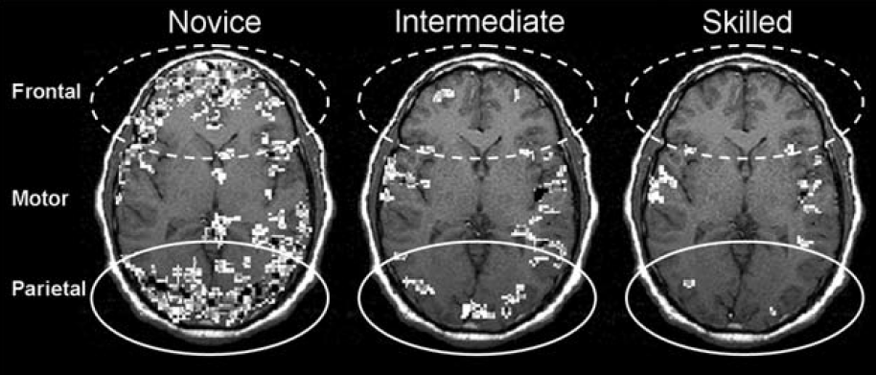
The Brain at Work
What is happening in the brain?
How does this feel?
Ericsson, K. Anders, et al., eds. The Cambridge handbook of expertise and expert performance. Cambridge University Press, 2006.

Slide 35
Brain Workload
Learning something new is
energy intensive = tiring
Ericsson, K. Anders, et al., eds. The Cambridge handbook of expertise and expert performance. Cambridge University Press, 2006.

Slide 36
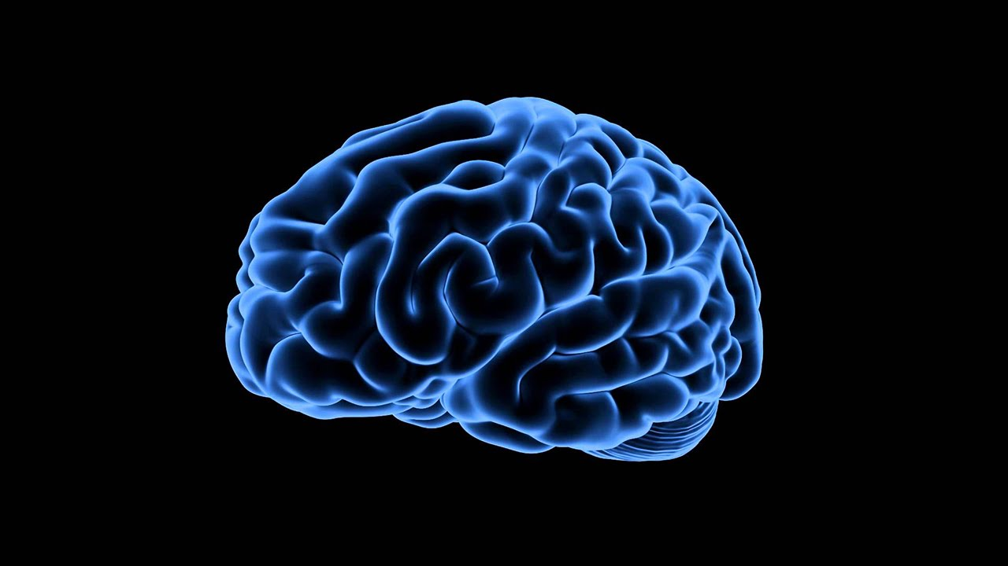
Tiring → Discouraging
Sensory Input
Executive Functions,
Focus
Amygdala

Slide 37
Fear
Survival Tool

Slide 38
Neurons that fire together wire together
Sensory and
Post-sensory
Executive Functions,
Focus
Amygdala

Slide 39
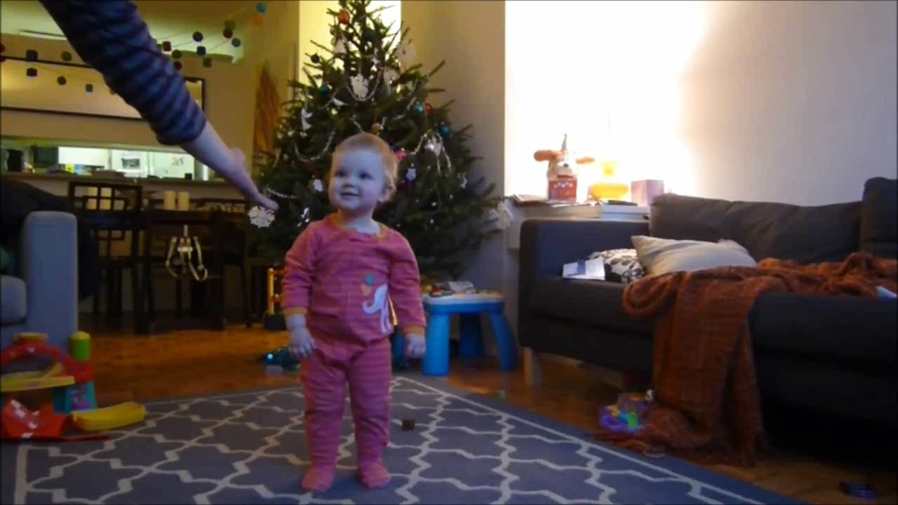
Random Toddler from the Internet

Slide 40
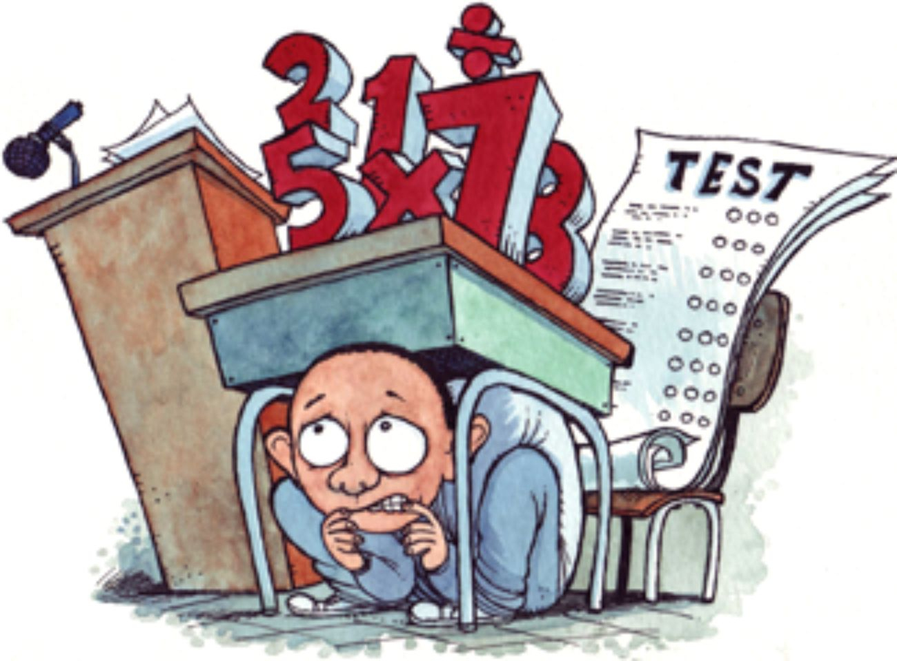
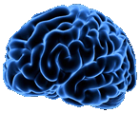
Anxiety!
Amygdala

Slide 41
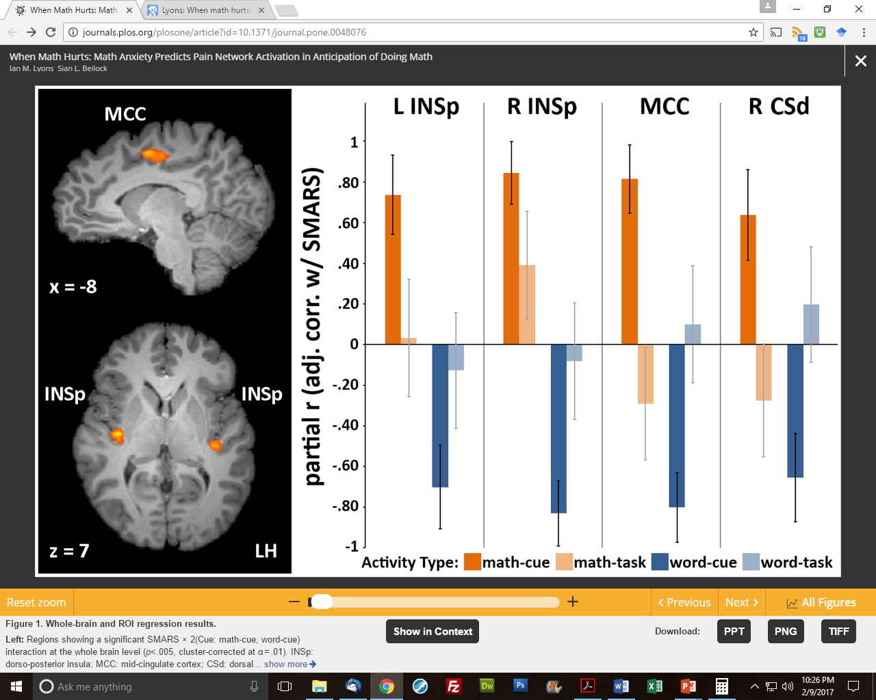
Math Anxiety!
Activation of brain regions associated with physical pain perception is strongest when anticipating a math task.
Lyons, I. M., & Beilock, S. L. (2012). When math hurts: math anxiety predicts pain network activation in anticipation of doing math. PloS one, 7(10), e48076

Slide 42

Math Anxiety!
7 x 9 -15 = ?

Slide 43
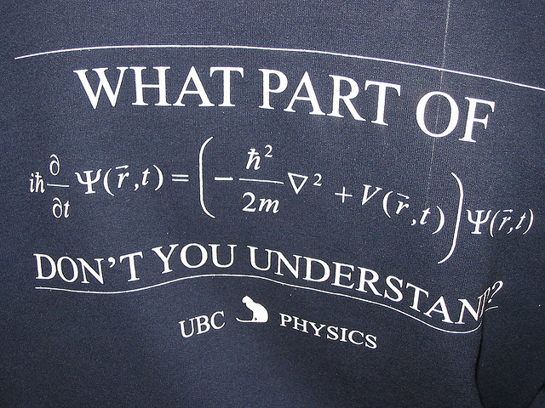
Notes:
Being hard.

Slide 44

Self-Efficacy
Your belief that you can do something well

Slide 45
Self-Efficacy
Ask whether students agree:
I was unable to think clearly when taking exams in this class.
Physics makes me feel uneasy.
I got really stressed when working on homework in this class.
I worried about my ability to solve physics problems on exams

Slide 46
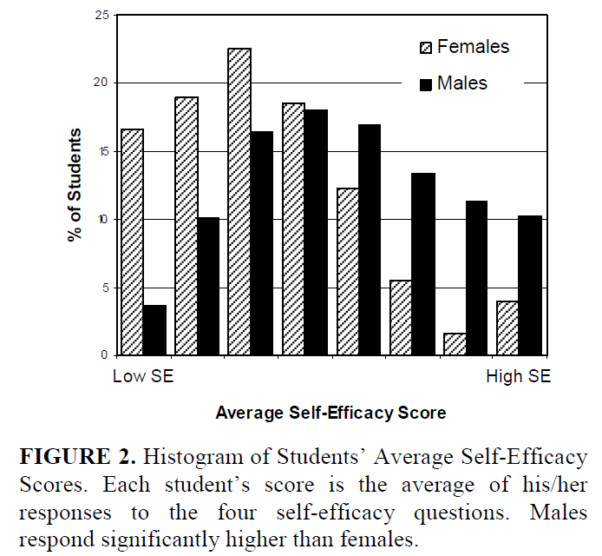
Self-Efficacy
Even when controlling for exam score, females have significantly lower SE than males
Kost, Lauren E., Steven J. Pollock, and Noah D. Finkelstein. "Unpacking gender differences in students’ perceived experiences in introductory physics." AIP conference proceedings. Eds. Mel Sabella, Charles Henderson, and Chandralekha Singh. Vol. 1179. No. 1. AIP, 2009.

Slide 47
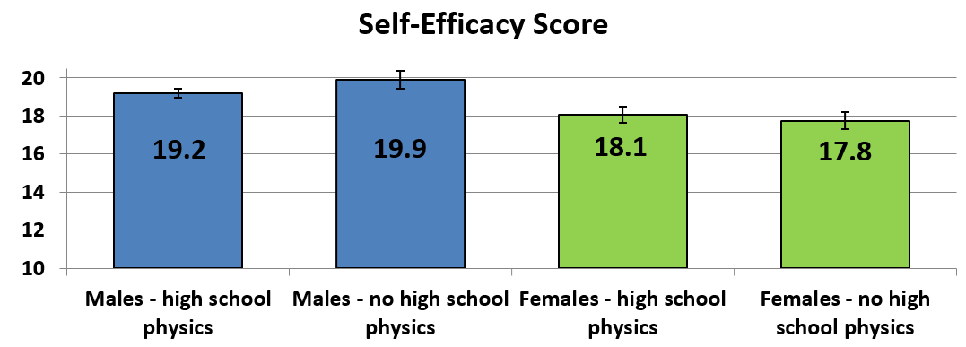
Self-Efficacy
Self-efficacy scores of
first-year physics students
“male overconfidence syndrome”
Lindstrøm, Christine, and Manjula D. Sharma. "Self-efficacy of first year university physics students: do gender and prior formal instruction in physics matter?." International Journal of Innovation in Science and Mathematics Education (formerly CAL-laborate International) 19.2 (2011).

Slide 48
Cognition
Survival Tool

Slide 49
Cognitive Learning Cycle
Do,
Test
Input
Plan
Assign Meaning
Zull, J. The Art of Changing the Brain. 2002
Notes:
Based on perception-cycle that brainy organisms use to interact with their environment.
When this cycle operates well, the brain makes rich sets of connections.

Slide 50
Learning = Making Connections
Force spins
Force deflects
Heavy things resist
R ↑, motion ↓
Motion dies away
Opposites cancel
F ∴ motion
Change takes time
Stronger wins
Objects squish with force
More effort = more resistance

Slide 51
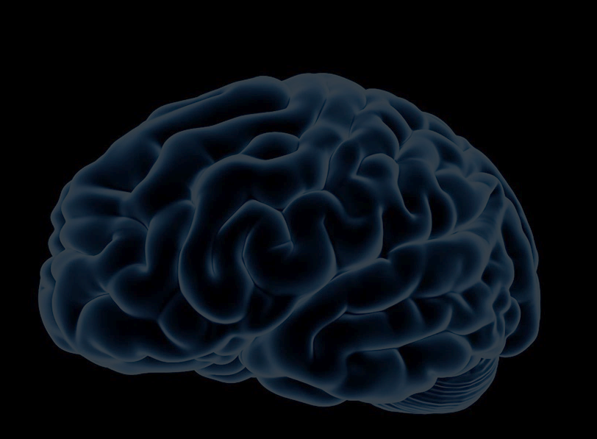
How to make connections?
Notes:
Now we can ask the question: “What should our instruction accomplish?” What type of experiences promote the re-wiring our students’ need?

Slide 52
Let me do it!
Do,
Test
Input
Plan
Assign Meaning
Zull, J. The Art of Changing the Brain. 2002
Notes:
Based on perception-cycle that brainy organisms use to interact with their environment.
When this cycle operates well, the brain makes rich sets of connections.

Slide 53
How to make connections?
Students must create connections themselves.
Notes:
Now we can ask the question: “What should our instruction accomplish?” What type of experiences promote the re-wiring our students’ need?

Slide 54
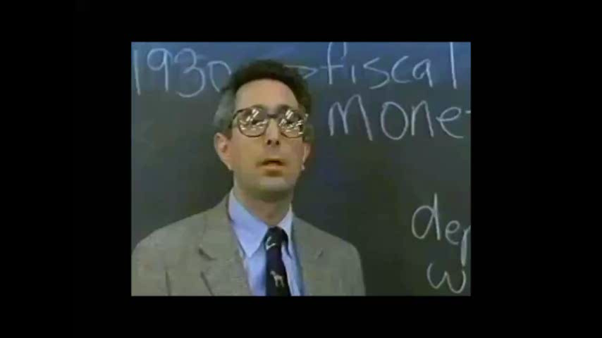
How to make connections?
Notes:
In teaching, for hundreds of years …

Slide 55
How to make connections?
More
Do,
Test
More!
Input
More!!
Plan
Assign Meaning
Zull, J. The Art of Changing the Brain. 2002
Notes:
Their brains want to do the cycle!
If you try to provide them with 20 years of science teaching wisdom, you are just providing more input that they don’t have the opportunity to process and sort out. This is why learning is so complex! The more “wisdom” we give, the less time students have to sort it out.

Slide 56
How to make connections?
More
ZZzzz...
More!
Input
More!!
Will to live fading
No meaning or interest
Notes:
Their brains want to do the cycle!
If you try to provide them with 20 years of science teaching wisdom, you are just providing more input that they don’t have the opportunity to process and sort out. This is why learning is so complex! The more “wisdom” we give, the less time students have to sort it out.

Slide 57
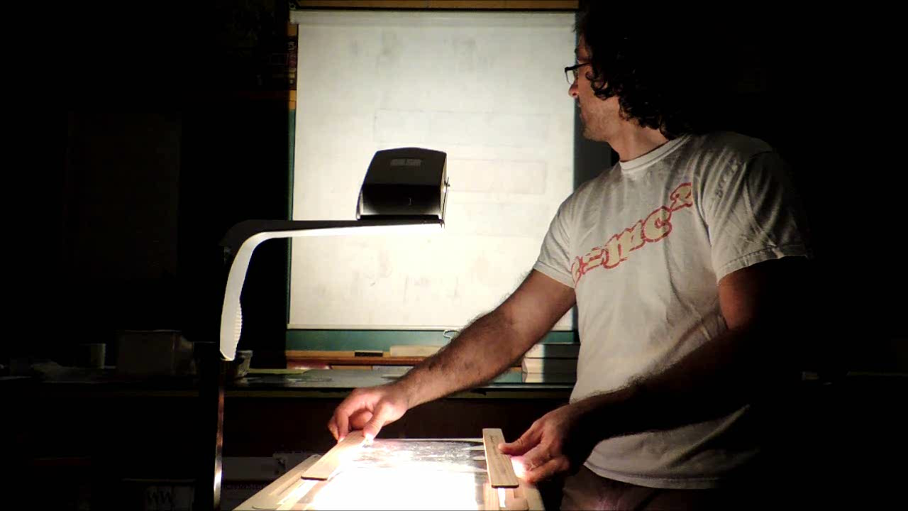
Exciting Demos!

Slide 58
Educational Demos!
Try to make demos educational:
Predict
Observe
Explain
Confront misconceptions!
Elicit → Confront → Resolve

Slide 59
Educational Demos!

Slide 60
Educational Demos!
What do students learn from this experience?

Slide 61
Educational Demos?
Draw prediction
Make a prediction?
Wrong!
Use graphing
ideas
Activate physics
experience
Bad!

Slide 62
Problematic Demos!
Neurons that fire together wire together
Use my I’m
experiences wrong
Cognition is not separate from emotion
Bad!
Etkina, Eugenia, and Alan Van Heuvelen. "Investigative science learning environment–A science process approach to learning physics." Research-based reform of university physics 1 (2007).

Slide 63
Problematic Demos!
World of Student
World of Physics
School Physics is Not Real
Redish, Edward F. Teaching physics: with the physics suite. Vol. 1. New Jersey: John Wiley & Sons, 2003.

Slide 64
Problematic Demos!
What has this demo accomplished?
Reinforces an incorrect knowledge resources (use = stronger)
Introduced negative emotion
Reduced self-efficacy
Set them up to fail
Bad!
Powerful!

Slide 65

Is the dark side stronger?

Slide 66
Upper and Lower Pathways
Thalamus
Sensory Input
Amygdala
Output
Notes:
Their brains want to do the cycle!
If you try to provide them with 20 years of science teaching wisdom, you are just providing more input that they don’t have the opportunity to process and sort out. This is why learning is so complex! The more “wisdom” we give, the less time students have to sort it out.

Slide 67
Upper and Lower Pathways
Processing
Processing
Thalamus
Sensory Input
Amygdala
Output
Notes:
Their brains want to do the cycle!
If you try to provide them with 20 years of science teaching wisdom, you are just providing more input that they don’t have the opportunity to process and sort out. This is why learning is so complex! The more “wisdom” we give, the less time students have to sort it out.

Slide 68
Metacognition
Understand and monitor the process of learning
You have mastered many challenging things in your life
Mistakes are necessary and valuable

Slide 69
Why do you like physics?
The thrill of discovery!

Slide 70
Cognition → Reward System
Do,
Test
Input
Plan
Assign Meaning
Zull, J. From Brain to Mind. 2011
Notes:
Based on perception-cycle that brainy organisms use to interact with their environment.
When this cycle operates well, the brain makes rich sets of connections.

Slide 71
Cognition → Reward System
Plan
Dopamine
Production
Zull, J. From Brain to Mind. 2011
Notes:
Based on perception-cycle that brainy organisms use to interact with their environment.
When this cycle operates well, the brain makes rich sets of connections.

Slide 72
Why do you like physics?
The thrill of discovery!
The high of addicts!
Physics junkies!

Slide 73
Pleasure!
Survival Tool

Slide 74
Success!
Educational Tool

Slide 75
Why is success so powerful?
Intrinsic Reward
vs.
Extrinsic Reward

Slide 76
Why is success so powerful?
Success
Interest Motivation

Slide 77
Guiding Principle
Students need:
many chances to be successful
to recognize, on their own, when they are successful

Slide 78
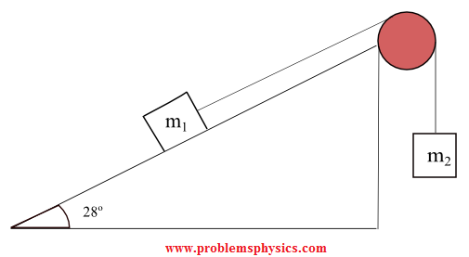
Standard Physics Problem
Released from rest, 1 m/s at top, find m₂

Slide 79
Add in Success!
Make it a rich task
Have students invest in it
Support students throughout it
Have students test it

Slide 80

Add in Success!

Slide 81
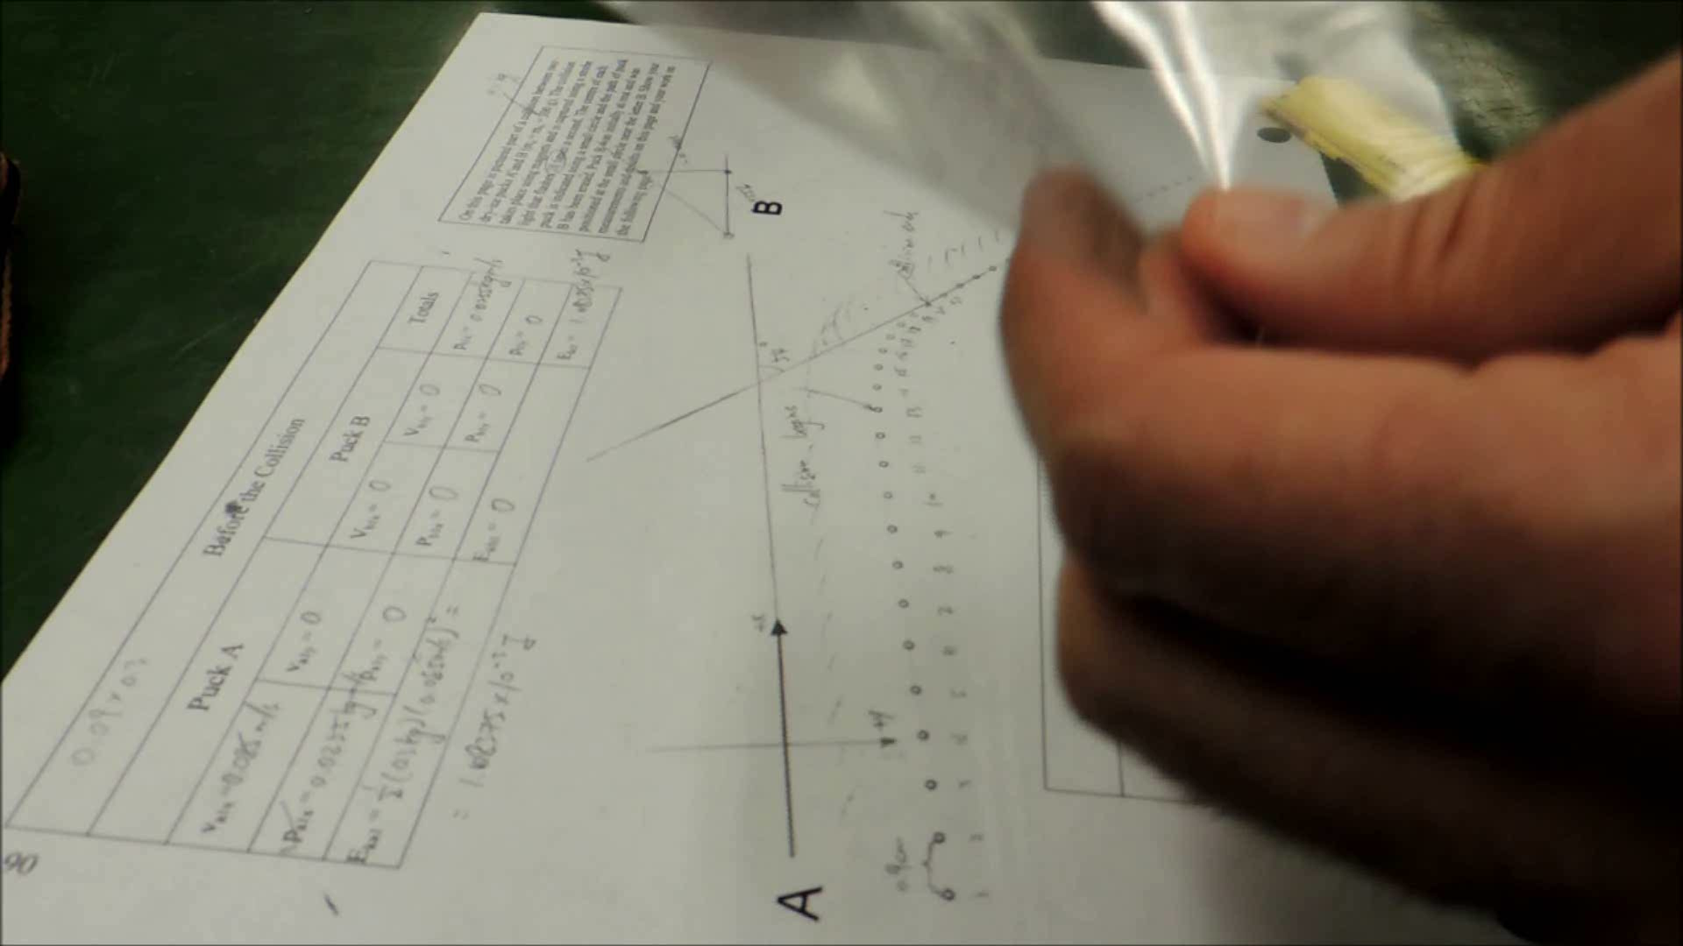
Have Students Test it

Slide 82
Invest in Ideas

Slide 83
Success!
How is this lesson designed to help students take ownership of ideas?
How is it designed to deliver installments of success?

Slide 84
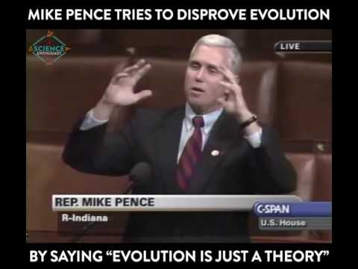
Understand
Students’ Emotions
Design your teaching with emotion in mind
Can’t deny evolution!

Slide 85
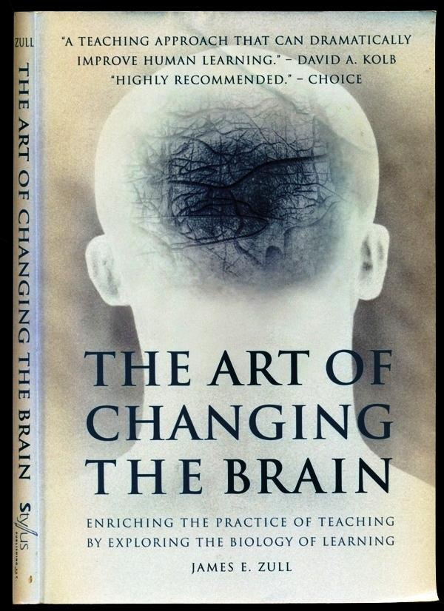

Slide 86
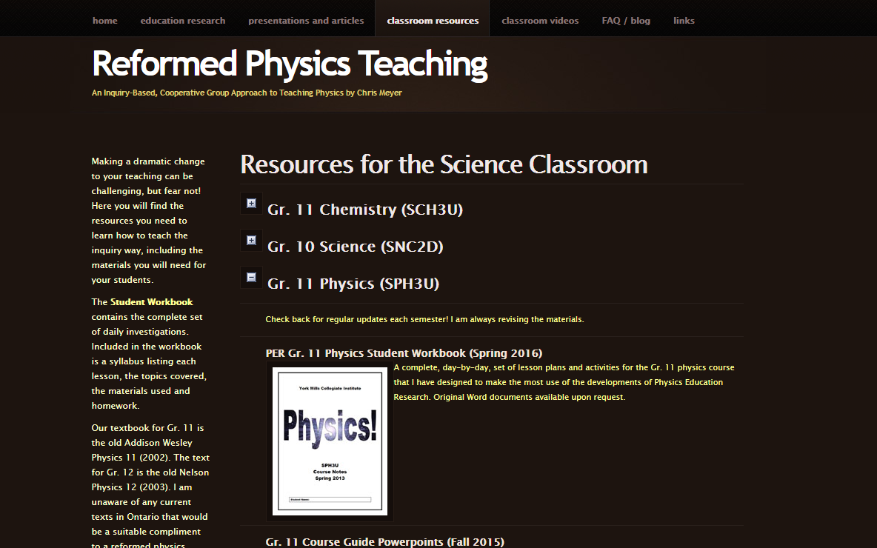
For more:

Slide 87
Harness Emotion to Improve Learning
Chris Meyer
York Mills C. I., Toronto District School Board
www.meyercreations.com/physics

